Slide 1
Webapps final presentation
Alan Vey
Octavian Tuchila
Sean Naderi

Slide 2
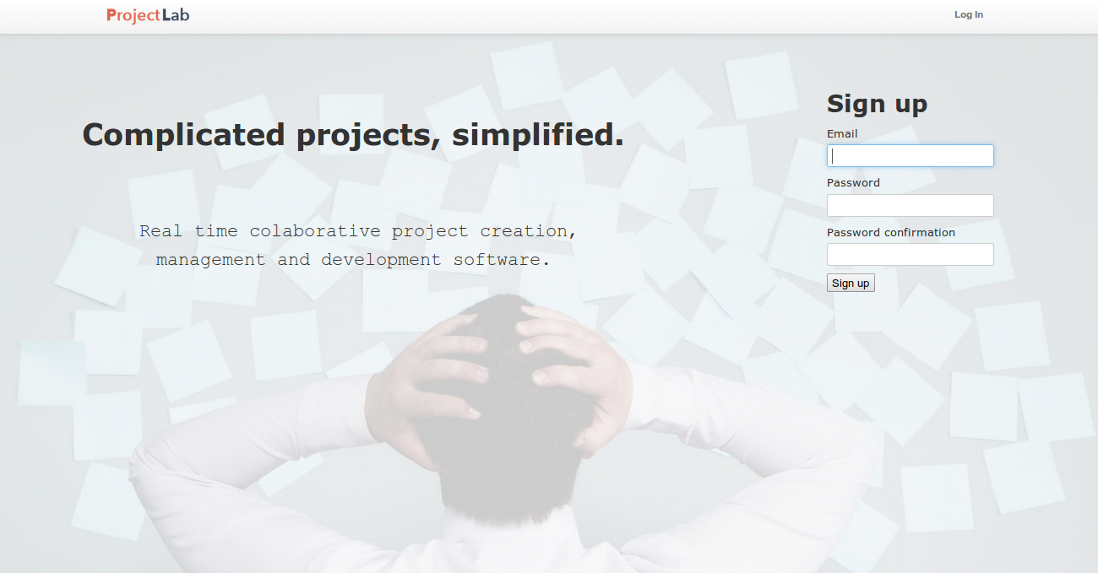
Idea: Project Management website
Features:
Multi-user environment
Database maintaining internal state such as login data
Projects contain milestones which have associated tasks
File editing environment which allows a user to see edits done by other users in real time, which creates a rich user environment
Messaging system
Burn down chart

Slide 3
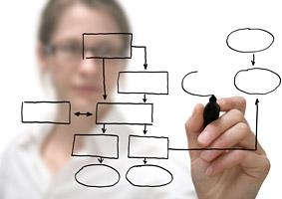
Project Organisation

Slide 4
Programming
Used Rails framework, so most of the development was done in Ruby
We also needed to know JavaScript/CoffeeScript, HTML, ERB, CSS
Testing framework: Rspec, Capybara, Factorygirl
SQL

Slide 5
For developing our project we have used:
Git – we branched of the main branch whenever we added a new feautre
Gitlab – milestones, issues
ProjectLab – our own website
Behaviour Driven Developement was helped by the testing framework
PostgreSQL
Heroku

Slide 6

Communication
Group meetings in person planned by Alan
And yeah, FaceTime

Slide 7
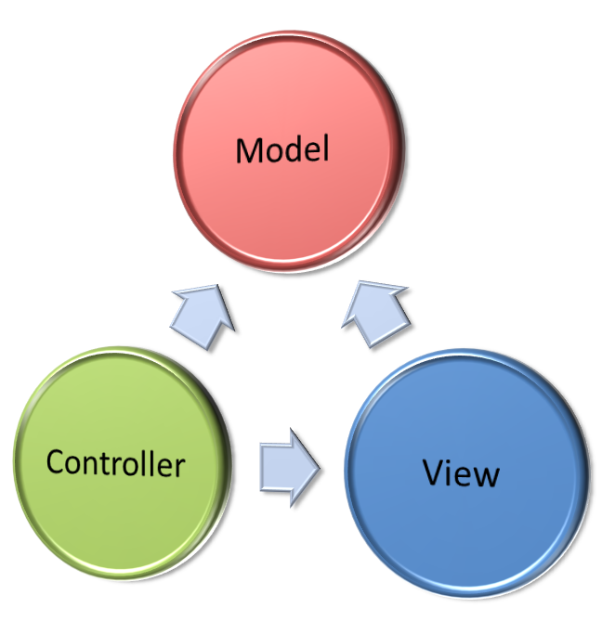
Implementation
Model-View-Controller
Model - data validation
View - HTML with embedded with JavaScript, Ruby
Controller - program logic

Slide 8

Styling

Slide 9
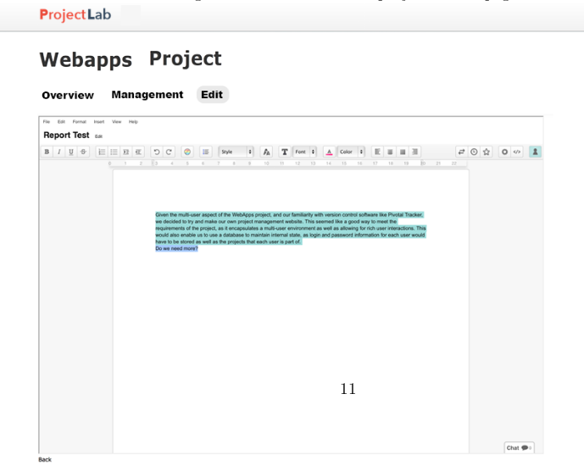
and … we’ve also bootstrapped our application

Slide 10
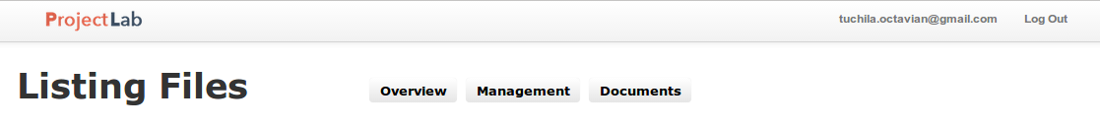
Navigation
Main navigation bar - fixed to the top of every page
Site logo - contains link to home page
Log In/Log Out button
User account button
Secondary Navigation bar - appears when a project is accessed
Overview
Management
Edit

Slide 11

Users
authentication done with Devise
can work on multiple projects

Slide 12

Projects
Associated with multiple users
On their show page, each one has a burndown chart, which was done using the gem googlevisualr
Contains
milestones
documents

Slide 13
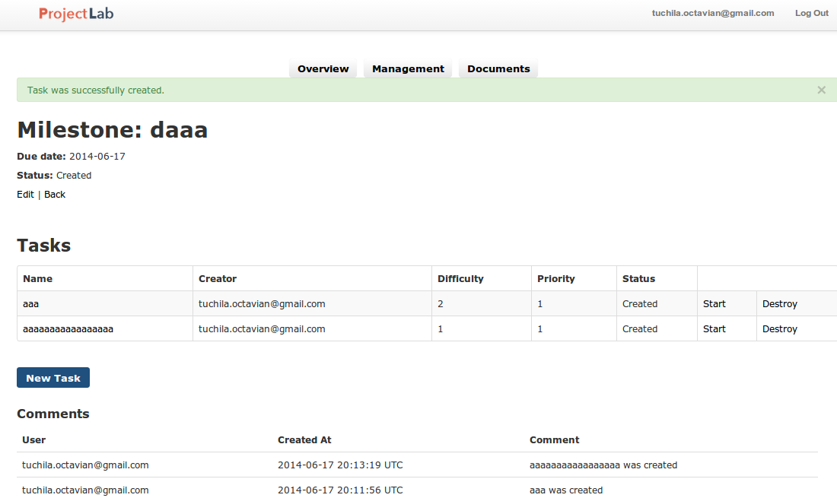
Milestones
Contain:
tasks
comments associated with the tasks

Slide 14
Tasks
Assigned difficulty estimated in days
Assigned priority ranging from low to critical
Data used for burndown chart

Slide 15

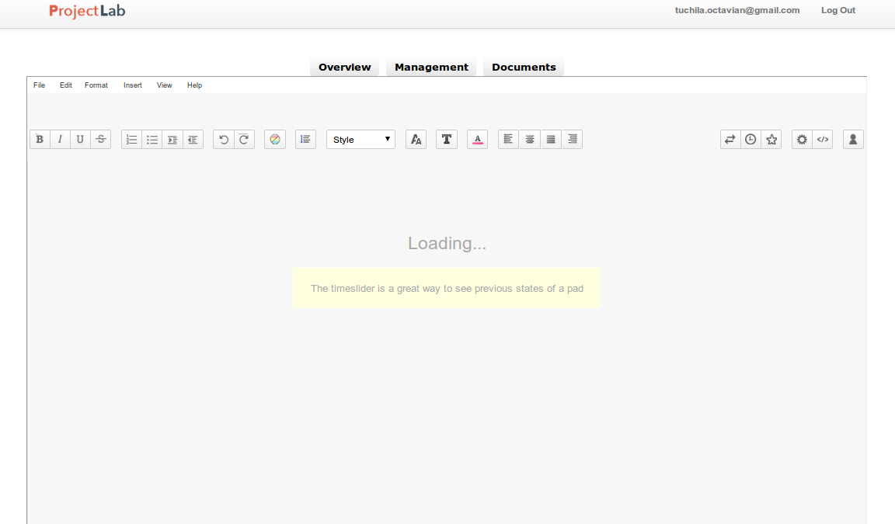
EtherPads
Shown using iFrame

Slide 16
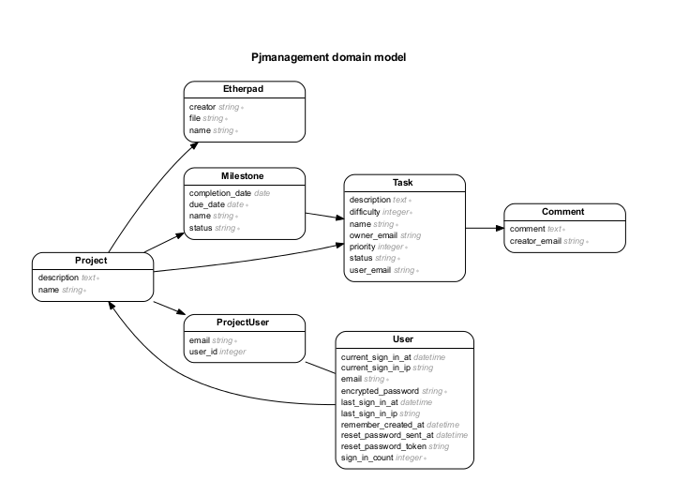
Database organisation

Slide 17
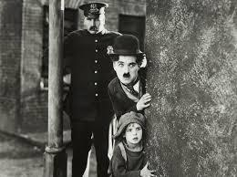
Legal part

Slide 18
Ruby and all the gems we have used are under dual licence
Ruby Licence, which has a copyleft status and is accepted by FSF under GPL
simplified BSD
We are allowed to use our project for non-commercial purposes

Slide 19

Commercial Release?
We can opt for JRuby, rather than the standard Ruby interpreter
JRuby licence: “this license is intended to facilitate the commercial use of the Program”

Slide 20
Background Image
Taken from a website which stated that the image can be copied to another website as long as the origin is mentioned
Pictures used in commercial release
done by us
obtain waiver from author

Slide 21
Possible extensions
• Help and supporting documentation
• User profiles and Private messaging
• Email notifications
• Contribution analysis
• Real time collaborative software for spreadsheets and presentations
• Gitlab integration

Slide 22
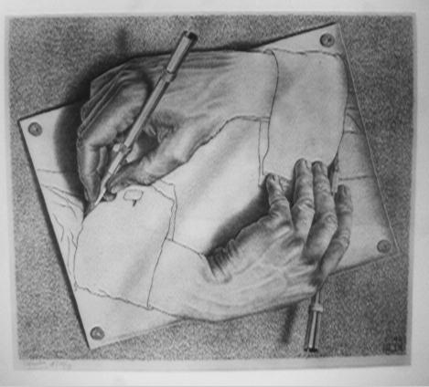
Our work on the webapps project helped us to understand what a project management website needs

Slide 23

Biggest Difficulty: Learning the Framework’s API and structure

